Slide 1

EXPLORATORY DATA ANALYSIS CAPSTONE PROJECT-01 EDA ON PLAY-STORE By: Sridhar Padhy Pranit Ransingh (Data Science Trainee, AlmaBetter)

Slide 2
Introduction :
Agenda
1.Reason for this project.
2.Problem Statement
3.Analytics
Team
4.Process
5.Problem Faced
6.Conclusion
Mobile apps are everywhere. They are easy to create and can be lucrative, because of these two factors, more and more apps are being developed.
Android is the dominant mobile operating system today more than 85% of all mobile devices running Google’s OS. The Google Play Store is the largest and most popular Android app store.
There are more than 3.04 million apps found on Google Play Store.
The Play Store apps data has enormous potential to drive app-making businesses to success.

Slide 3





Reason To Analyze Google Playstore :
We can see in today day to day life we are connected by various apps knowingly or unknowingly. Mobile application are everywhere and can be easily developed
The Play store app data has as enormous potential in in application development field and can be a huge success if analysed in correct way.
Mobile App Market is set to grow 20% by 2023
What are some interesting patterns in user behavior related to app usage & reviews
Android Apps comprise 90% of the Mobile App Market
What makes an App popular? Can we predict how popular it’s going to be?

Slide 4

Problem Statement
To , explore and analyze datasets are provided, one with basic information and the other with user reviews for the respective app and discover all the key factors responsible for app engagement and success.
Our mission is to understand and provided the information to who all want to step inside the Play store app market.
what is the motivating factor for people to download an app?
What are the relationships between installs, prices, ratings, reviews, and categories ?

Slide 5
Analytics Team
Pranit Ransingh
Sridhar padhy

Slide 6

Process
Data Understanding
Data Cleaning
Find Null values
Data Wrangling
Exploratory data analysis
Notes:
In order to get the conclusion we have to get in depth of the problem and try ways to solve it
There are large amount of Rows and Columns in the data which makes it more challenging and a lot more interesting .
To see oh how much data we are working on , we have been provided with 2 datasets.
First one is the Play store data that consists information about the app category, its rating , size, installs , content rating and many more things
The second dataset consists of the review data which consists of the translated review, sentiments and many more

Slide 7
Process Flowchart:
Loading the data sets: Two datasets, First Play store app
dataset and User Reviews dataset.
Import Libraries: NumPy, Pandas, Seaborn and Matplotlib
Data cleaning: Null values, Finding and removing Outliers, Removing duplicate data.
Data Imputation: Filling the missing categorical values with mode and numerical values with median. Conversion of price, installs, reviews into numerical values.
Exploratory Data Analysis: Analyzing the data sets to summarize their main characteristics using statistical graphics and data visualizations method.

Slide 8
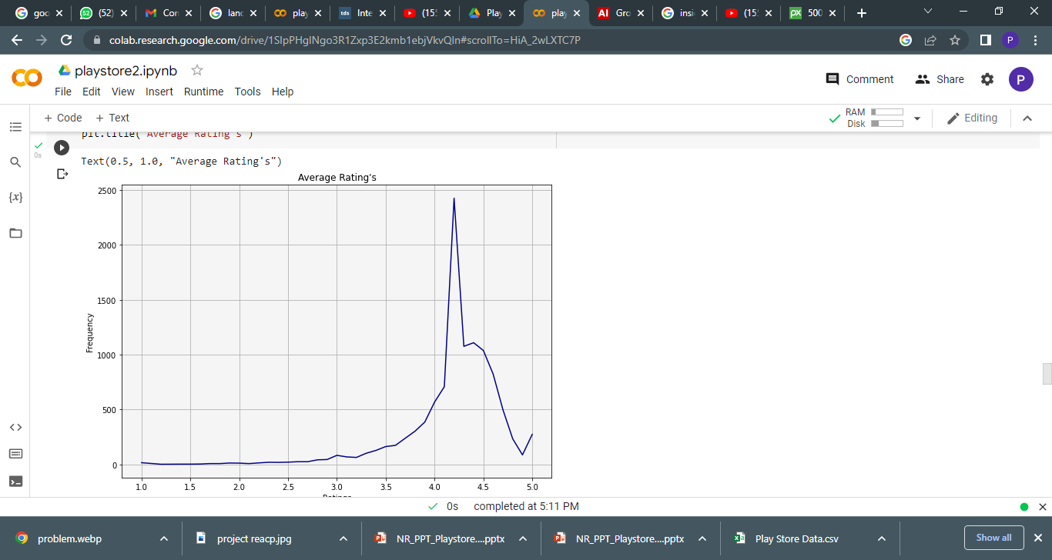
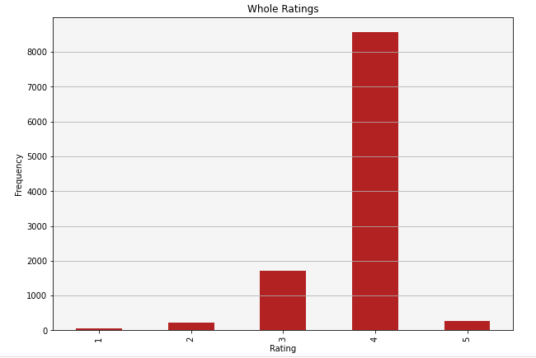
Observation-1 Average Rating

Slide 9
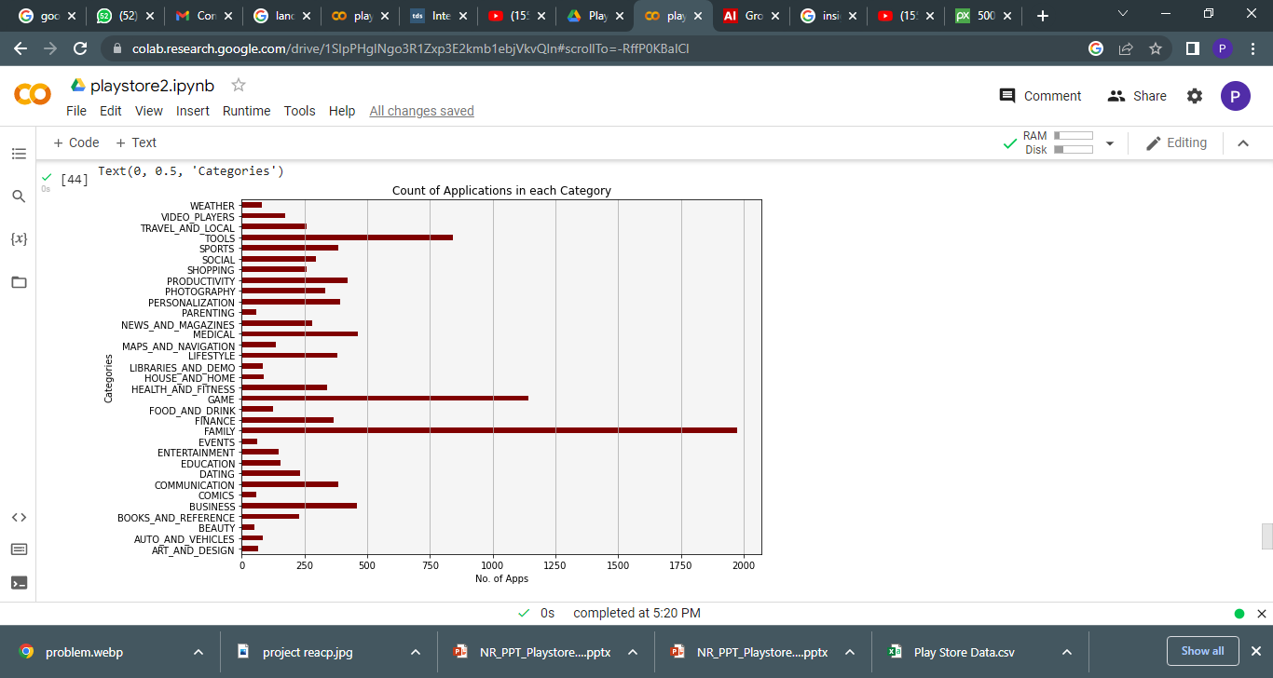
Observation-2

Slide 10
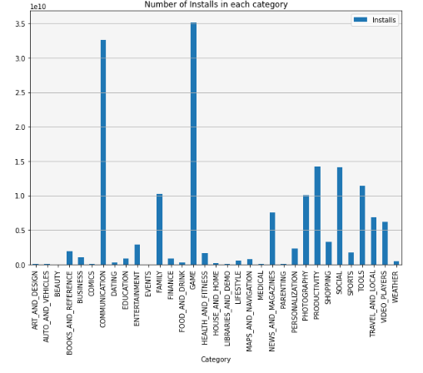
Observation-3

Slide 11
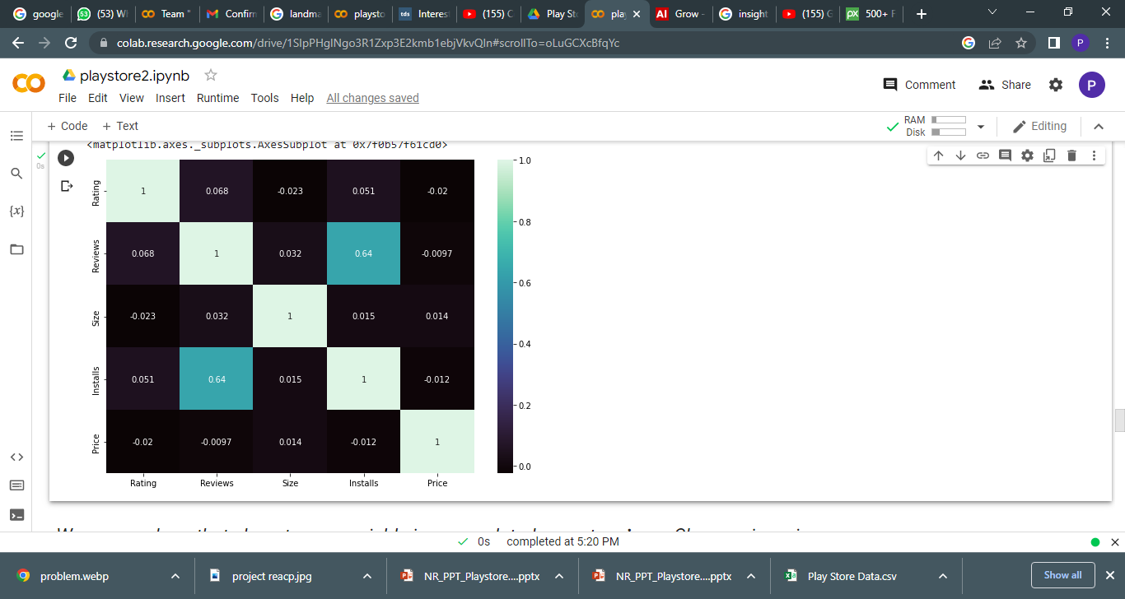
Observation-4

Slide 12
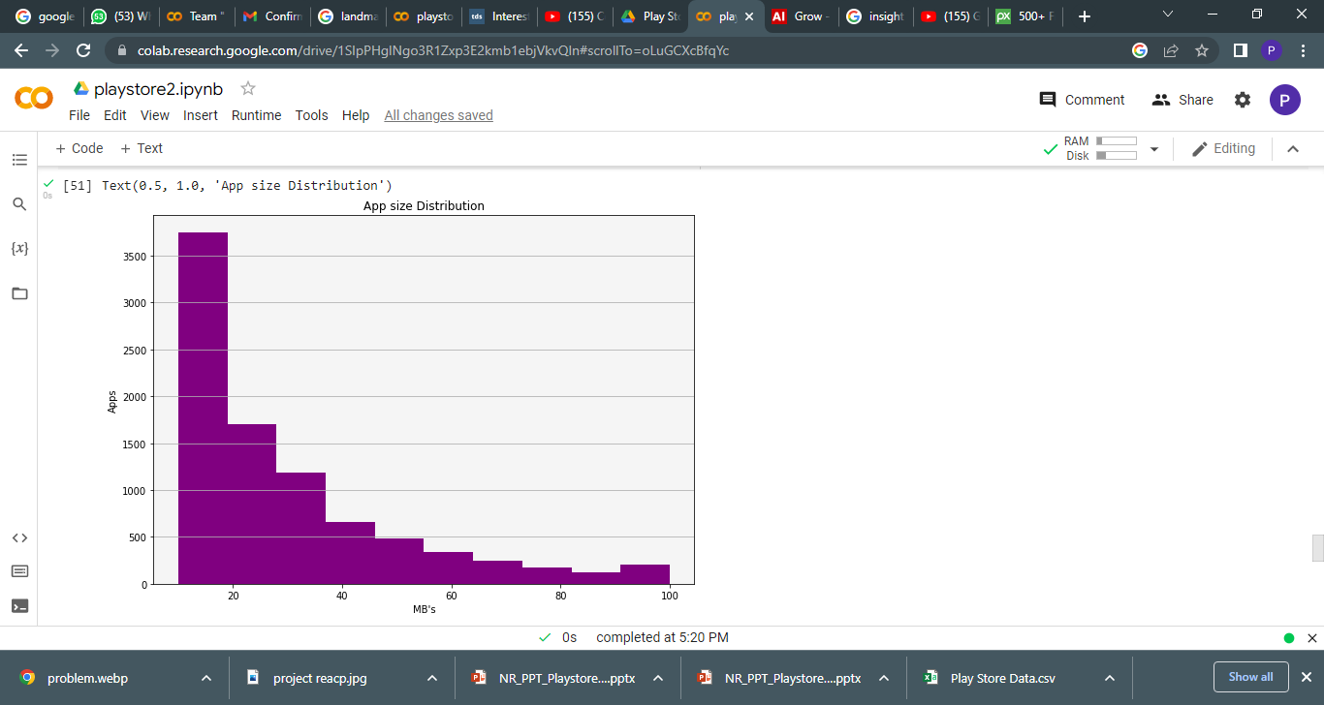
Observation-5

Slide 13
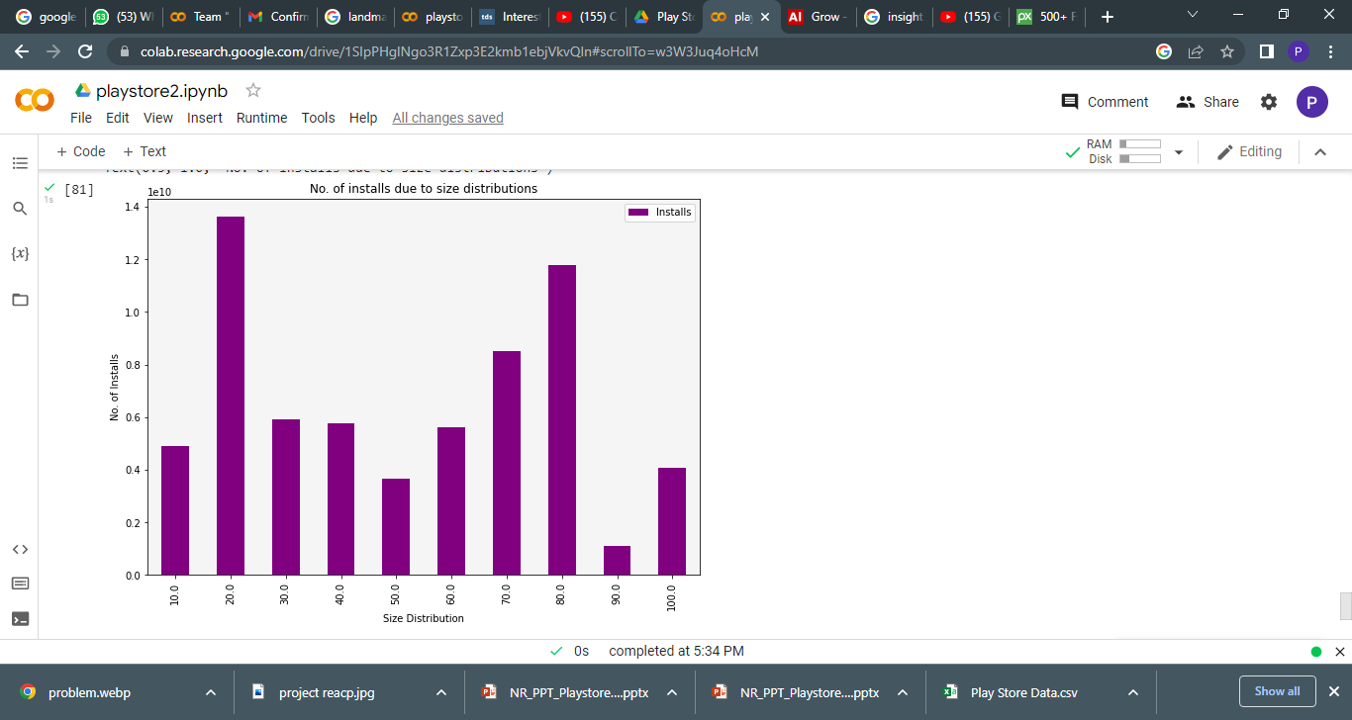
Observation-6

Slide 14
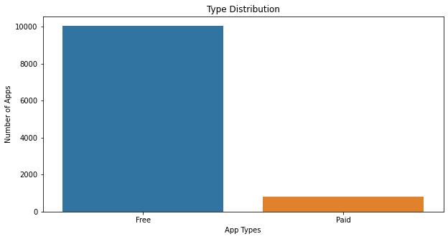
Observation-7
Major Type of app distribution in Play store.
Majority of app in the play store is free due to which it create major effect in installment or the review and rating.

Slide 15
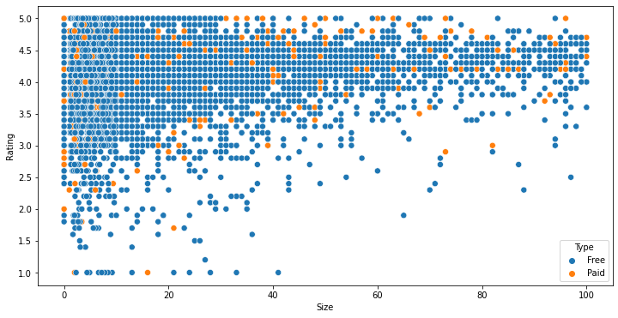
Observation-8
Distribution of apps in term of their rating, size and type
we can conculed that majority of the free apps are small in size and having high rating. While for paid apps, we have quite equal distribution in term on size and rating. so , free app and small size app create much more effect then orthers.

Slide 16
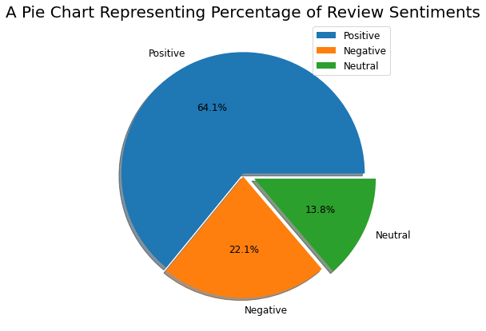
Observation-9
Review Sentiments:
As we can see it from the pie charts there are 64.1 % of Positive sentiments, 22.1% of Negative sentiments, and 13.8% neutral sentiments.

Slide 17
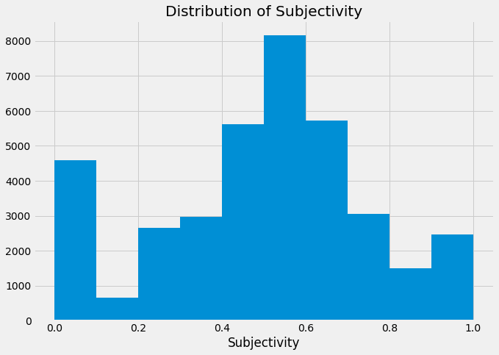
Observation-10
It can be seen that the maximum number of sentiment subjectivity lies between 0.4 to 0.7. From this, we can conclude that the maximum number of the audience give reviews to the applications, according to their experience.

Slide 18
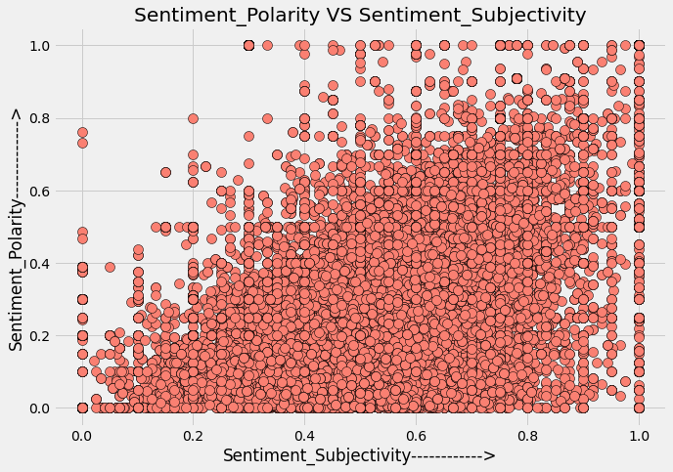
Observation-11
Does sentiments Polarity is proportional to sentiments subjectivity
From the above scatter plot it can be concluded that sentiment subjectivity is not always proportional to sentiment polarity but in maximum number of case, shows a proportional behavior.

Slide 19

Problem – Faced
Reading the dataset and comprehending the problem statement.
Examining the business KPIs for app development and devising a solution to the problem.
Handling the error, duplicate and NaN values in the dataset.
Designing multiple visualizations to summarize the information in the dataset and successfully communicate the results and trends to the reader.

Slide 20
Conclusion:
So , We can Conclued that before starting any kind of exploration the data cleaning play a vital role in result and accuracy.
As we all can see the many observations and conclusion that arise from the data visualization and how visualizations make anything interesting with the graphs, plots, chart or maps.
Which simplify the data and can be easily understand the role of the data and their elements in the diverse world of play store.
As per the graphs visualizations shown above, most of the trending apps (in terms of users' installs) are from the categories like GAME, COMMUNICATION, and TOOL even though the amount of available apps from these categories are twice as much lesser than the category FAMILY. The trending of these apps is most probably due to their nature of being able to entertain or assist the user. Besides, it also shows a good trend where we can see that developers from these categories are focusing on the quality instead of the quantity of the apps.
Other then this also can be say that mostly the app has higher number of user installs or review gives the app a good rating and mostly all the apps are around the rating of 4 (8000 apps).Also the size and price of the app create a minute difference but not majorly effect the app with good rating, review even if their app size are high. But due to free in charges we get the higher number of user installs and ratings.
Also, it can be seen from the chart that the sentiments play important role and maximum number of sentiment which are positive around (64.1 %) lies between subjectivity 0.4 to 0.7. From this, we can conclude that the maximum number of the audience give reviews to the applications, according to their experience.
As, we can see that, why exploring data is important before starting to build ML models
As a conclusion, we learnt that the current trends in the Android market are mostly from these categories which assisting, communicating or entertaining apps.

Slide 21


